Slide 1

NuSpace Internship 2022
What did I do?

Slide 2
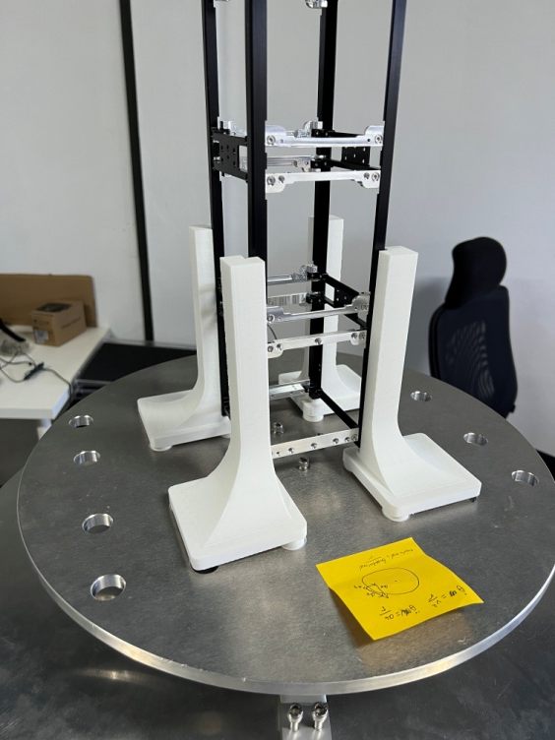
Main Mission: CGMOI machine
Integrated SPDT, DPDT relays and Arduino Mega to allow for reversible current supplied to linear actuators
Integrated 3 ADCs with 3 load cells and Arduino Mega to obtain mass and CG coordinates.
Set up a gyroscope with Arduino Mega to measure angular acceleration of rotation in order to calculate MOI.
Set up stepper motor, stepper motor driver and Arduino Mega to provide constant torque when measuring MOI.

Slide 3
Main Mission: CGMOI machine
Set up the power supply for the machine.
Designed and wrote an Arduino script with FreeRTOS to manage all the aforementioned components.
Designed a PCB using KiCad to connect all aforementioned components when ADCs, relays and Arduino Mega are stacked onto PCB.
Picked up soldering.
Designed a PCB enclosure using SOLIDWORKS which was then 3D printed.

Slide 4
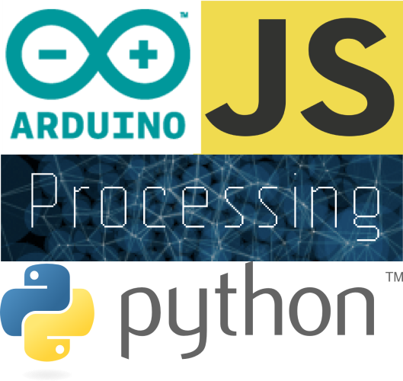
SIDE QUESTS
Taught a group of 20 17-18 year old students about the basics of Python programming.
Participated in the assembly of a class 1 clean room.
Contributed to the assembly process of a nano-satellite by stripping and crimping wires.

